Slide 1
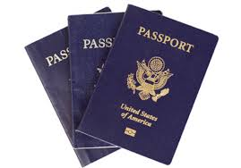
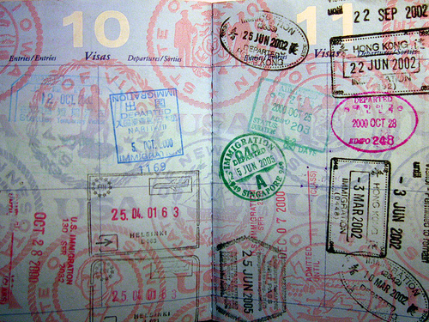
Passports

Slide 2





Quick Overview
Serves as add-on to Facebook and LinkedIn
Allows you to follow the location of your travelling Facebook and LinkedIn contacts in real-time, and see what they’re doing on their trip through pictures and video snippets
Provides offers and special deals from local restaurants and retailers, and other businesses

Slide 3
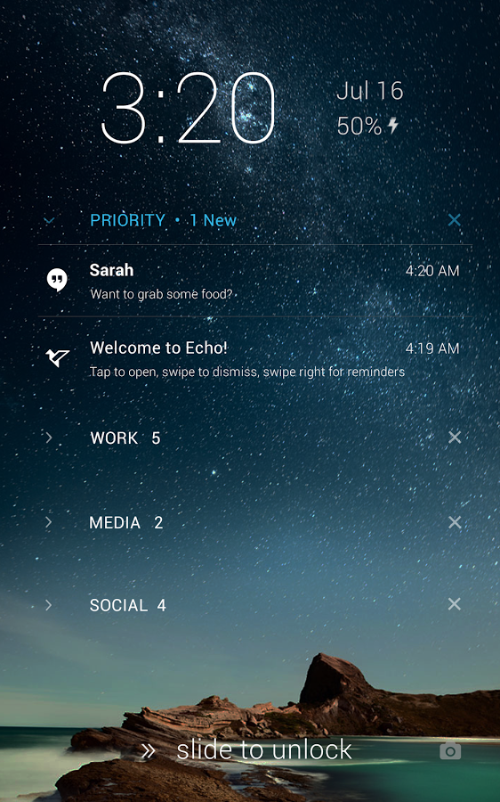

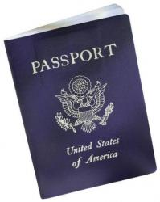
Notification of “Active” Passport
IOS
Android
Passports Active
Passports Active

Slide 4


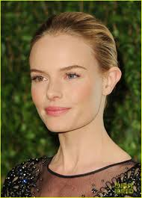


Active Passports
List of Active Contacts
George Clooney
Buenos Aires, Argentina
Today; Now
Kate Bosworth
Rio de Janeiro, Brazil
Today; 9:34 PM
Robert Downey Jr.
Miami, FL (US),
Today; 8:15PM
Oprah Winfrey
Los Angeles, CA (US),
Today; 5:30PM
By hovering over the Globe, you will also see those contacts who were recently active

Slide 5
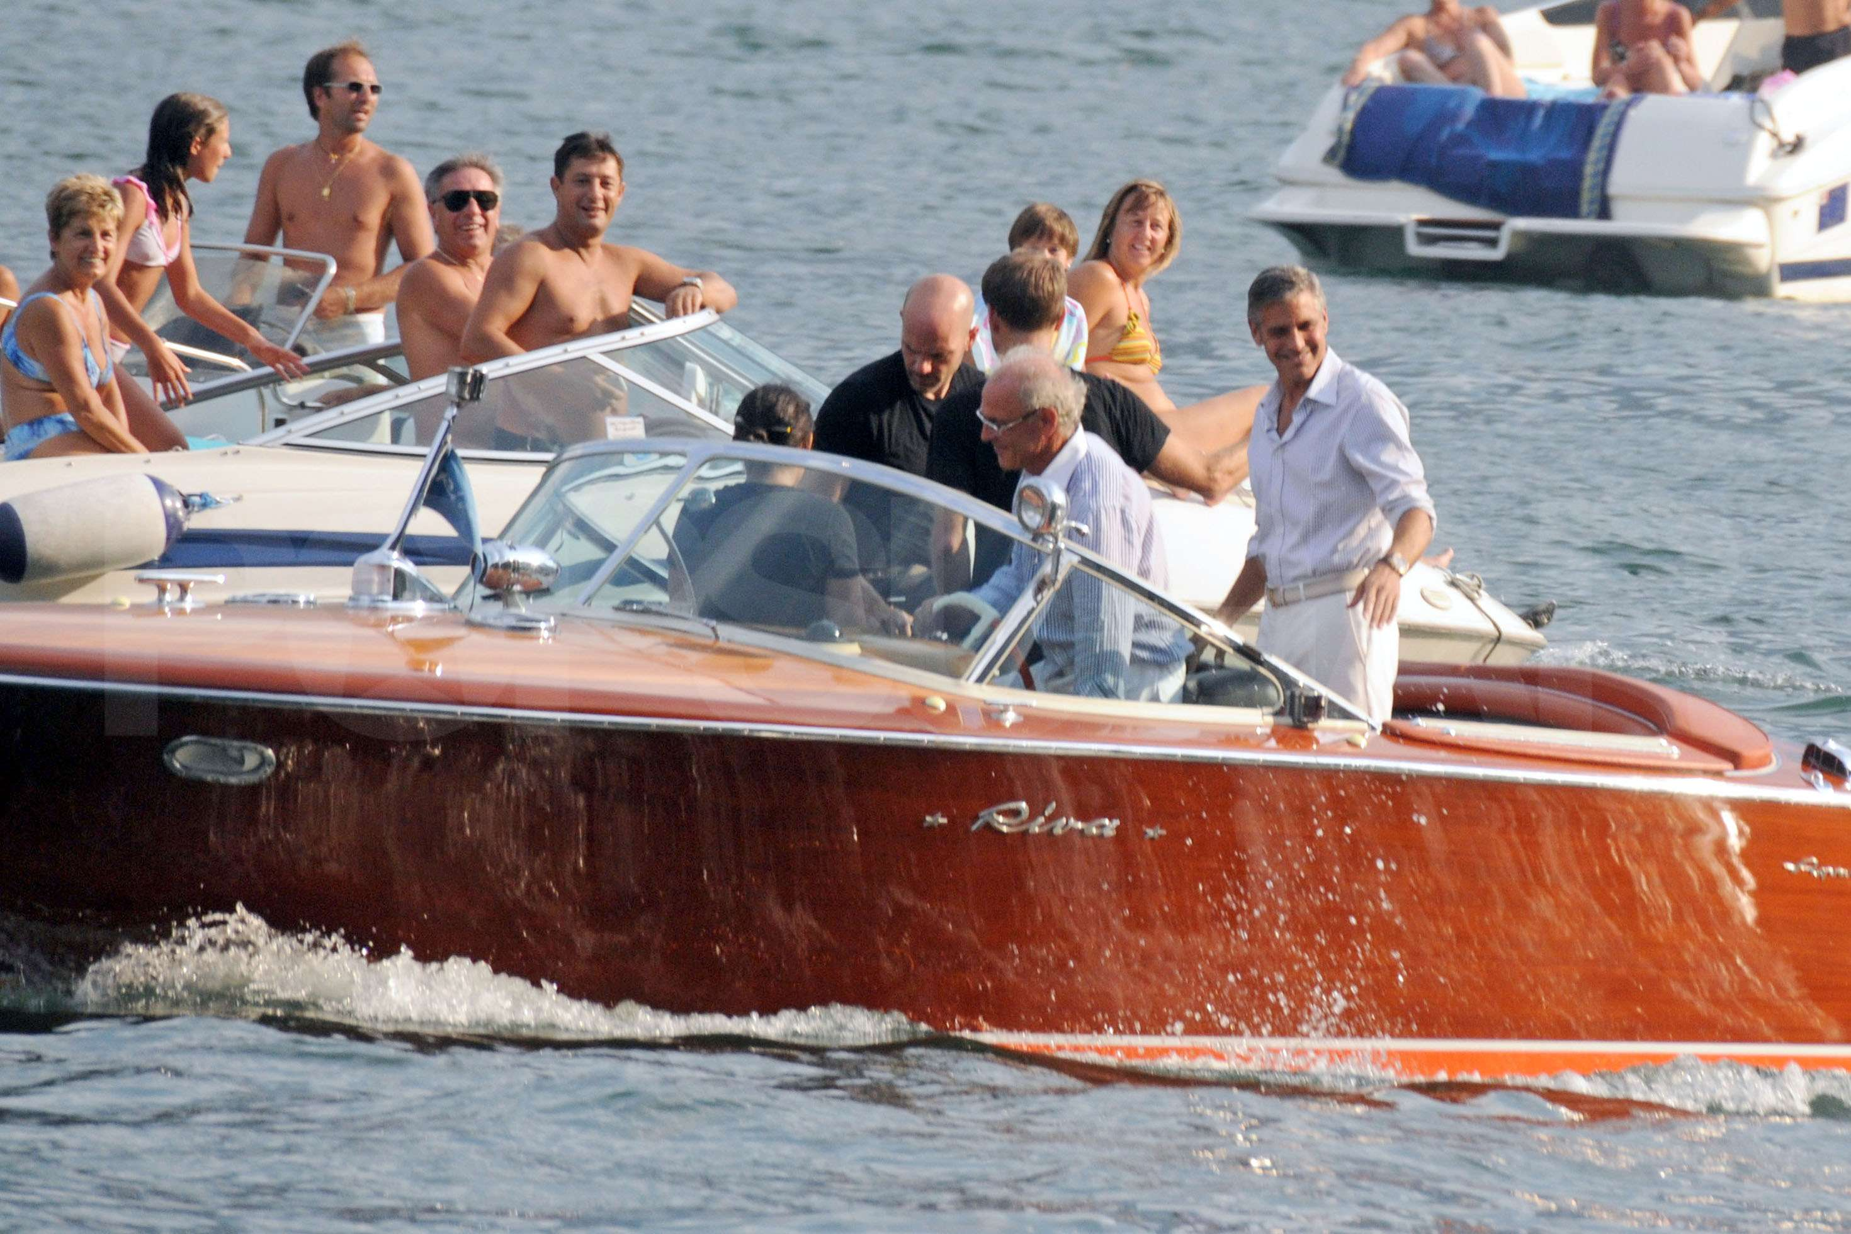
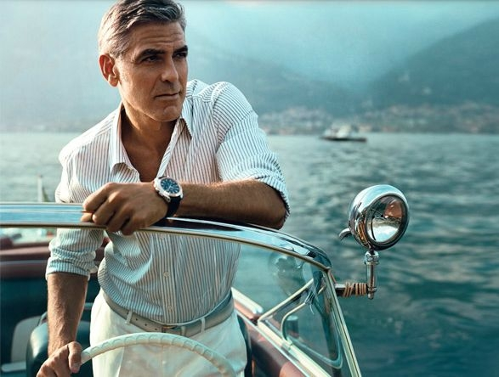
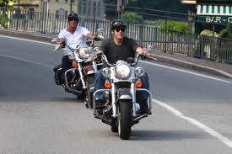

Contact: George Clooney
Current Location: Buenos Aires, Argentina
“Rented a boat from Messi’s Boat House. Great boats and even better service.”
“Enjoying the wind in my air while in the ocean!”
“Rented a Harley from Harley of Buenos Aires. Great ride along the coast with my buddy Leo!”

Slide 6
User Status Levels
Silver
Requirement
20 hours active/month
Benefits
Get 10% discount at local retailers
Gold
Requirement
40 hours active/month
Benefits
Get 20% discount at local retailers
Free city tour of select cities through World Tour Guides
Platinum
Requirement
60 hours active/month
Benefits
Get 40% discount at local retailers
Free city tour of select cities through World Tour Guides
Reduced admission to participating nightclubs and bars in select cities

